Slide 1
Text and Fonts
Chpt 17

Slide 2
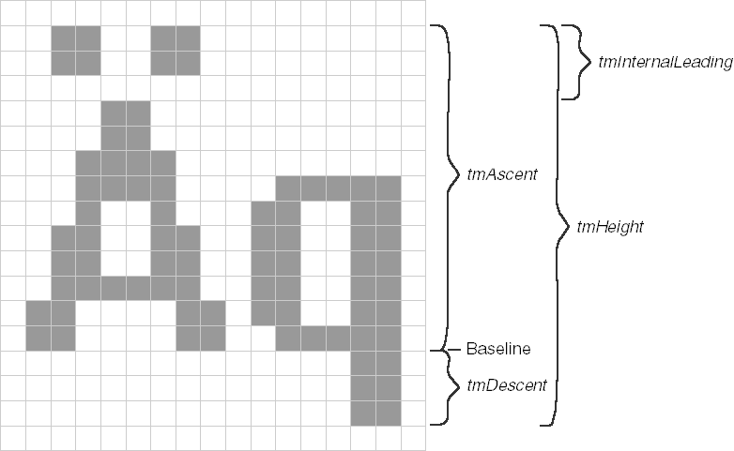
Text Size – Fig 5-3

Slide 3
TextOut()
TextOut(hdc, xStart, yStart, pString, iCount);
x/yStart are the starting position of the string in LOGICAL coordinates (upper left corner of 1st character)
iCount is the length of the string
SetTextAlign() can be used to alter the start position
TA_LEFT, TA_RIGHT, TA_CENTER affect how xStart is used while TA_TOP, TA_BOTTOM, and TA_BASELINE flags affect how yStart is used
TA_UPDATECP flag causes Windows to ignore xStart and yStart and instead uses the current position previously set by MoveToEx() or LineTo(). It also causes TextOut() to update the current position to the end of the string (useful for multiple lines of text).

Slide 4
TabbedTextOut()
TabbedTextOut(hdc, xStart, yStart, pString, iCount, iNumTabs, piTabStops, xTabOrigin)
Useful for tabbed (column) displays
Text with ‘\t’ or 0x09 embedded characters will be expanded into spaces based on the array of integers passed in

Slide 5
ExtTextOut()
ExtTextOut(hdc, xStart, yStart, iOptions, &rect, pString, iCount, pxDistance)
Similar to TextOut() but extended to now use a rectangle struct which is a clipping rectangel if iOptions is set to ETO_CLIPPED or a bacground rectangle filled with the current background colour if iOptions is set to ETO_OPAQUE
pxDistance is used to specify the spacing between characters (e.g. used in justification of a narrow column)

Slide 6
DrawText()
DrawText(hdc,pString, iCount, &rect, iFormat);
Rect structure defines a rectangle where you want text to appear
pString, if defined using a NULL-terminated string, can have iCount = -1, otherwise iCount should indicate the number of characters in the string
iFormat=0, windows interprets the text as a series of lines that are separated by carriage-returns (‘\r’). Text is drawn starting at the top left corner of the rectangle
iFormat types: DT_LEFT (left justified), DT_RIGHT (right justified), DT_CENTER (centred text in the rectangle), DT_SINGLELINE (ignore ‘\r’ characters and can use DT_TOP or DT_BOTTOM to move line to the top or bottom of the rectangle or DT_VCENTER to centre vertically)

Slide 7
DrawTextEx()
DrawTextEx(hdc,pString, iCount, &rect, iFOrmat, &drawtextparams)
DRAWTEXTPARAMS structure is used when string will have tabstops

Slide 8
DC text attributes
SetTextColor(hdc,rgbColor) – sets text colour
GetTextColor(hdc) – gets the current text color
SetBkMode(hdc,iMode) – iMode=OPAQUE or TRANSPARENT, sets the background mode (text box around text)
SetBkColor(hdc, rgbColor) – sets the text background colour
SetTextCharacterExtra(hdc,iExtra) – sets the extra spacing between characters (default = 0) in logical units

Slide 9
Stock Fonts
Previously reviewed text functions use the font currently selected in the DC
Fonts define typeface and size
Stock fonts: hFont = GetStockObject(iFont), then select into DC using SelectObject(hdc, GetStockObject(hFont))
…FIXED_FONT uses fixed width fonts (all characters same width) making text outputs easier
Use GetTextMetrics() to obtain the characters height and average character width

Slide 10
Types of fonts
GDI fonts found on files on harddrive
Device Fonts are native to output devices (Eg. Printers often have their own built in fonts)
GDI fonts:
  raster fonts – stored as a bitmap pixel pattern, not really resizable, limited sizes, fast to draw (System, FixedSys, Terminal, Courier, MS Serif, MS Sans Serif, Small fonts)
  Stroke fonts – series of line segments, scalable, slow to draw, small and large sizes result in poor quality (Modern, Roman, Script)
  TrueType fonts – defined by filled outlines of straight lines and curves, scaled by altering coordinates defining their outlines, windows “rasterizes” the font using “hints” included in the TrueType font file to scale the font to compensate for rounding errors, these fixed versions are stored for future reuse (Currier New, Times New Roman, Arial, Symbol)

Slide 11
Attributes/Styles
Raster fonts are made italic, underlined, and bolded by adjusting the raster image (e.g. italic is right shifting the top of the character)
TrueType fonts have a version of each style (e.g. Times New Roman Bold, Times New Roman Italic, etc.)
To select a font you can name them fully or specify the desired attributes

Slide 12
Point Size
Typography has you specify a font by its typeface name and size
Size is expressed in points
A point is close to 1/72 of an inch
Size is described as the height of the characters from the top of the ascenders without diacritics to the bottom of the descenders (e.g. max of “bq”)

Slide 13
Leading and Spacing
Leading – tmInternalLeading refers to extra space for diacritics (e.g. the ‘`’ found above characters in French for accent); tmExternalLeading refers to additional space between successive lines of characters
Height of a font is height of font less internal leading

Slide 14
Font Size and Points
Windows uses a system font with 10-point font and 12-point line spacing regardless of whether you pick “small font” or “large font” and regardless of what video pixel dimension you’ve selected
When “small font” is selected you are selecting an assumed video display resolution in dots per inch, in this case 96dpi (large uses 120dpi)
Examining Fig 5-3 (shown at start of these notes) is a small font. 10 points = 10/72 of an inch which when multiplied by 96dpi is approx. 13 pixels which is tmHeight – tmInternalLeading
12-point spacing gives (12/72)” * 96dpi = 16 pixels = tmHeight
Test yourself – calculate the “large font” and verify with fig 5-4 that the font height and spacing is 16 pixels and 20 pixels

Slide 15
Logical Inch
GetDeviceCaps() with LOGPIXELSX or …Y can be used to get the implied resolution of the device
The metrical distance occupied by 96dpi or 120dpi on the screen can be said to be a logical inch – however this will not appear on the screen as an actual inch due to resolution capabilities of a video screen vs. a printer (which would have 96dpi or 120dpi per real inch)

Slide 16
A bit of math
“twip” is “one twentieth of a point” thus 1/1440 of an inch
So a 10-point font is 10/72 of an inch or 200 twips.
If your resolution is 96dpi then your 10-point font is 200*96/1440 or approx 13 pixels in height
Instead of using windows mapping modes as defined it’s best to use your own mapping modes for a defined resolution e.g.
SetMapMode(hdc, MM_ANISOTROPIC);
SetWindowExtEx(hdc, 1440 1440, NULL);
SetViewportExt(hdc, GetDeviceCaps(hdc,LOGPIXELSX), GetDeviceCaps(hdc,LOGPIXELSY), NULL);

Slide 17
Getting Fonts
Use CreateFont() or CreateFontIndirect() to construct a request of the type of font you would like
They take 14 parameters (or a struct with 14 components)
Use SelectObject() to attempt to get the best matching font Windows can find matching your request
You can also enumerate all the fonts on a device and choose from these
You can simply call ChooseFont()

Slide 18
Logical Fonts
Create a logical font by calling CreateFont or CreateFontIndirect
Select the logical font into the device using SelectObject(). Windows choose a real font that mostly matches the logical font
Determine the size and characteristics of the real font using GetTextMetrics() so you can space the text properly
Delete the logical font using DeleteObject() AFTER it has been removed from the DC.
Note: GetTextMetrics() returns a TEXTMETRIC struct filled out by Windows with the metrics of the font while LOGFONT is a struct that YOU filled out to request certain metrics for Windows to try and match

Slide 19
Examples
PickFont.exe – demos the results found in TEXTMETRICS structure of making specific choices in the LOGFONT structure.
EZFont.cpp – shows how you can easily select a TrueType font using just the name of the font and it’s point size. EXTest.exe demos this being used. You can try changing the font name for different fonts used in the test (and recompile).
ChosFont.exe – shows the built in font dialog box for selecting fonts. Users select the font and attributes then select OK. The dialog returns the LOGFONT structure to use.

Slide 20
Text Formatting
Paragraph formatting is simply left, right, centre, or justified of text
To format a line of text you need to know the actual length of the text based on the current font selected.
GetTextExtentPoint32(hdc, pString, iCount, &size) – width and height of the text in logical units is returned in the “size” parameter
Assuming you have margins defined as xLeft and xRight, calculate xStart – the value for the hoziontal coordinate where text begins
Get the text extents using GetTextExtentPoint32()
If size.cx > (xRight – xLeft) – line is too long to fit within margins

Slide 21
Text Formatting: Alignment
Left alignment: set xStart = xLeft and write the text TextOut(hdc, xStart, yStart, szText, lstrlen(szText)). Add size.cy to yStart for new line
Right alignment: set xStart = xRight – size.cx
Centre alignment: set xStart = (xLeft + xRight – size.cx)/2
Justified: distance between margins = (xRight – xLeft); without justification text size = size.cx; difference between them must be equally distributed among the space characters in the string (xRight – xLeft – size.cx). Use SetTextJustification(hdc, xRight – xLeft – size.cx, numSpaces). Note, SetTextJustification() accumulates error whenever space doesn’t equally distribute – clear the error using SetTextJustification(hdc,0,0)

Slide 22
Paragraph Formatting
Paragraphs are more difficult since you must scan through the text looking for space characters calling GetTextExtentPoint32() to determine if the text still fits between left and right margins.
When you pass the text that fits, go back one step – that’s the size of text that fits. Use the previous technique to format the line. Repeat for rest of text.
Process is harder when multiple fonts are used in the same line
See Justify1.exe for an example
Justify2.exe shows an attempt at dealing with previewing printer output

